Slide 1
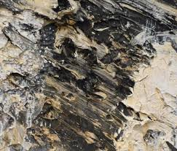
YEAR 10:
SURFACE

Slide 2
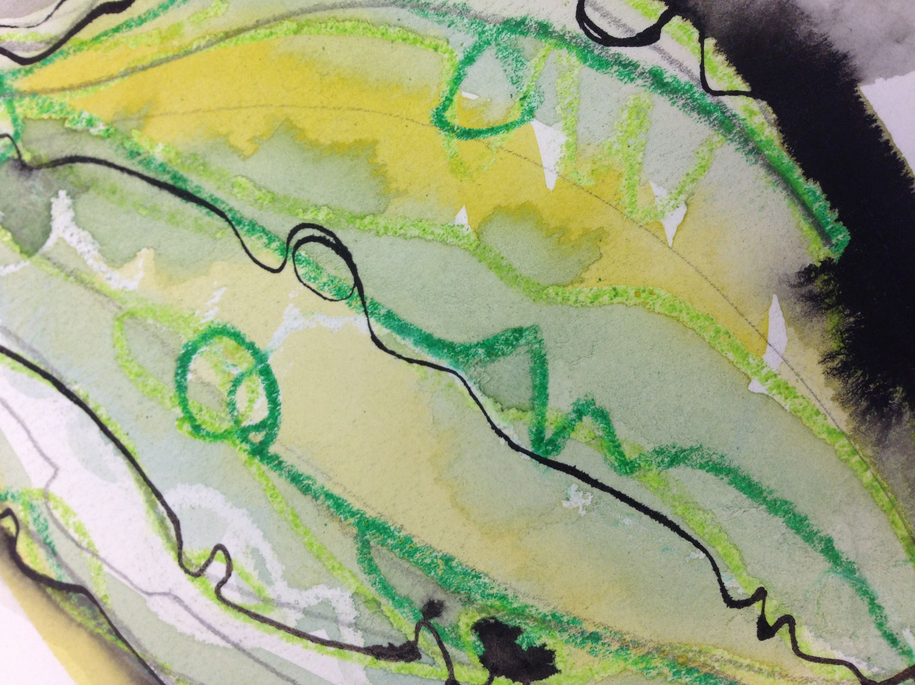
TASK 1: ABSTRACT SURFACE
Explore your house and garden find an unusual surface and try to recreate it.
YWBAT: Recreate your surface up close so you have an abstract piece of work. Min size 15cm x 15cm
You could use pencil, colour paint anything you have to hand.
Be free with your marks and try to follow the contours of the surface.

Slide 3
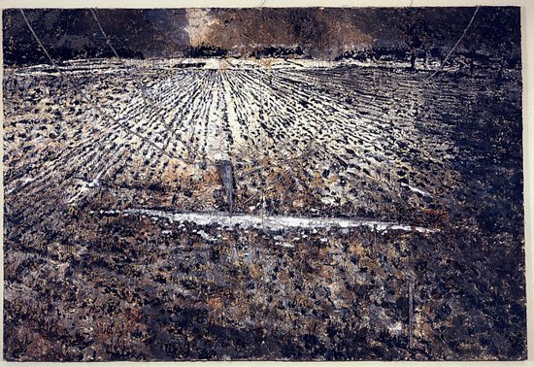
TASK 2
YWBAT: Research Artist Anselm Kiefer.
Produce a least one page on the Artist, this should include images of his work and details about him.
Consider how your work relates to his.
What do you think of his Art?

Slide 4
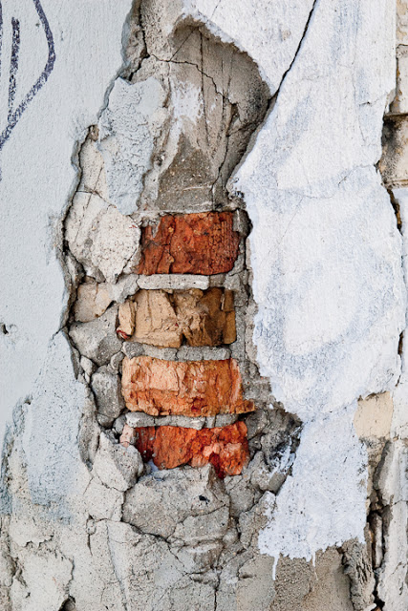
TASK 3:
PHOTOGRAPHIC INVESTIGATION
YWBAT: Explore your environment and identify interesting surfaces.
Walk around your house and garden and take interesting abstracted images of surfaces. You will need to capture and present at least 9 images as a series.
Send your images to you teacher via class charts.
ARTIST TIP: Could you use Photoshop or similar application to edit and refine your images.

Slide 5
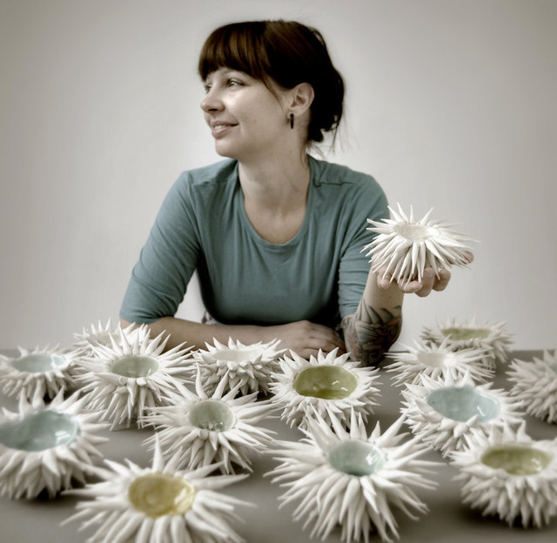
TASK 4:
YWBAT: Investigate the work of Ceramic Artists
Research the work of Heather Knight
Create a power-point presentation on the Artist.
You should include the following details:
Who are they?
What work have they created/designed?
Include a quote from them.
What inspires her?
What do you think of their work?

Slide 6
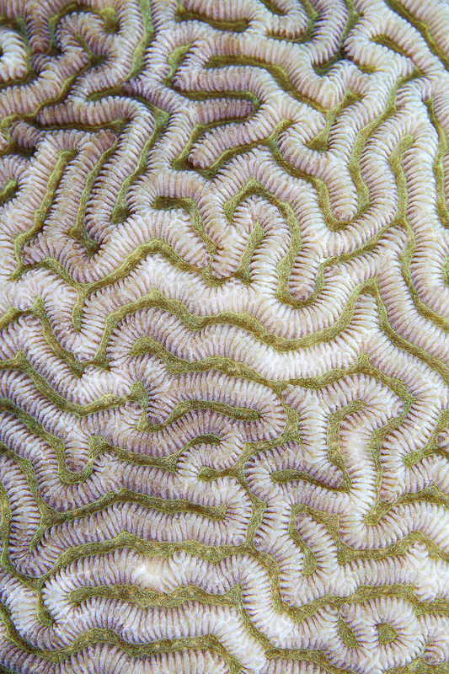
TASK 5:
YWBAT: Draw something that has Inspired the work of Heather Knight
Research images of Coral and Sea Urchins.
Draw from these to create your own inspired Art work.
Work should be minimum size A4.
ARTIST TIP: Use a light pencil outline to plan your study.

Slide 7
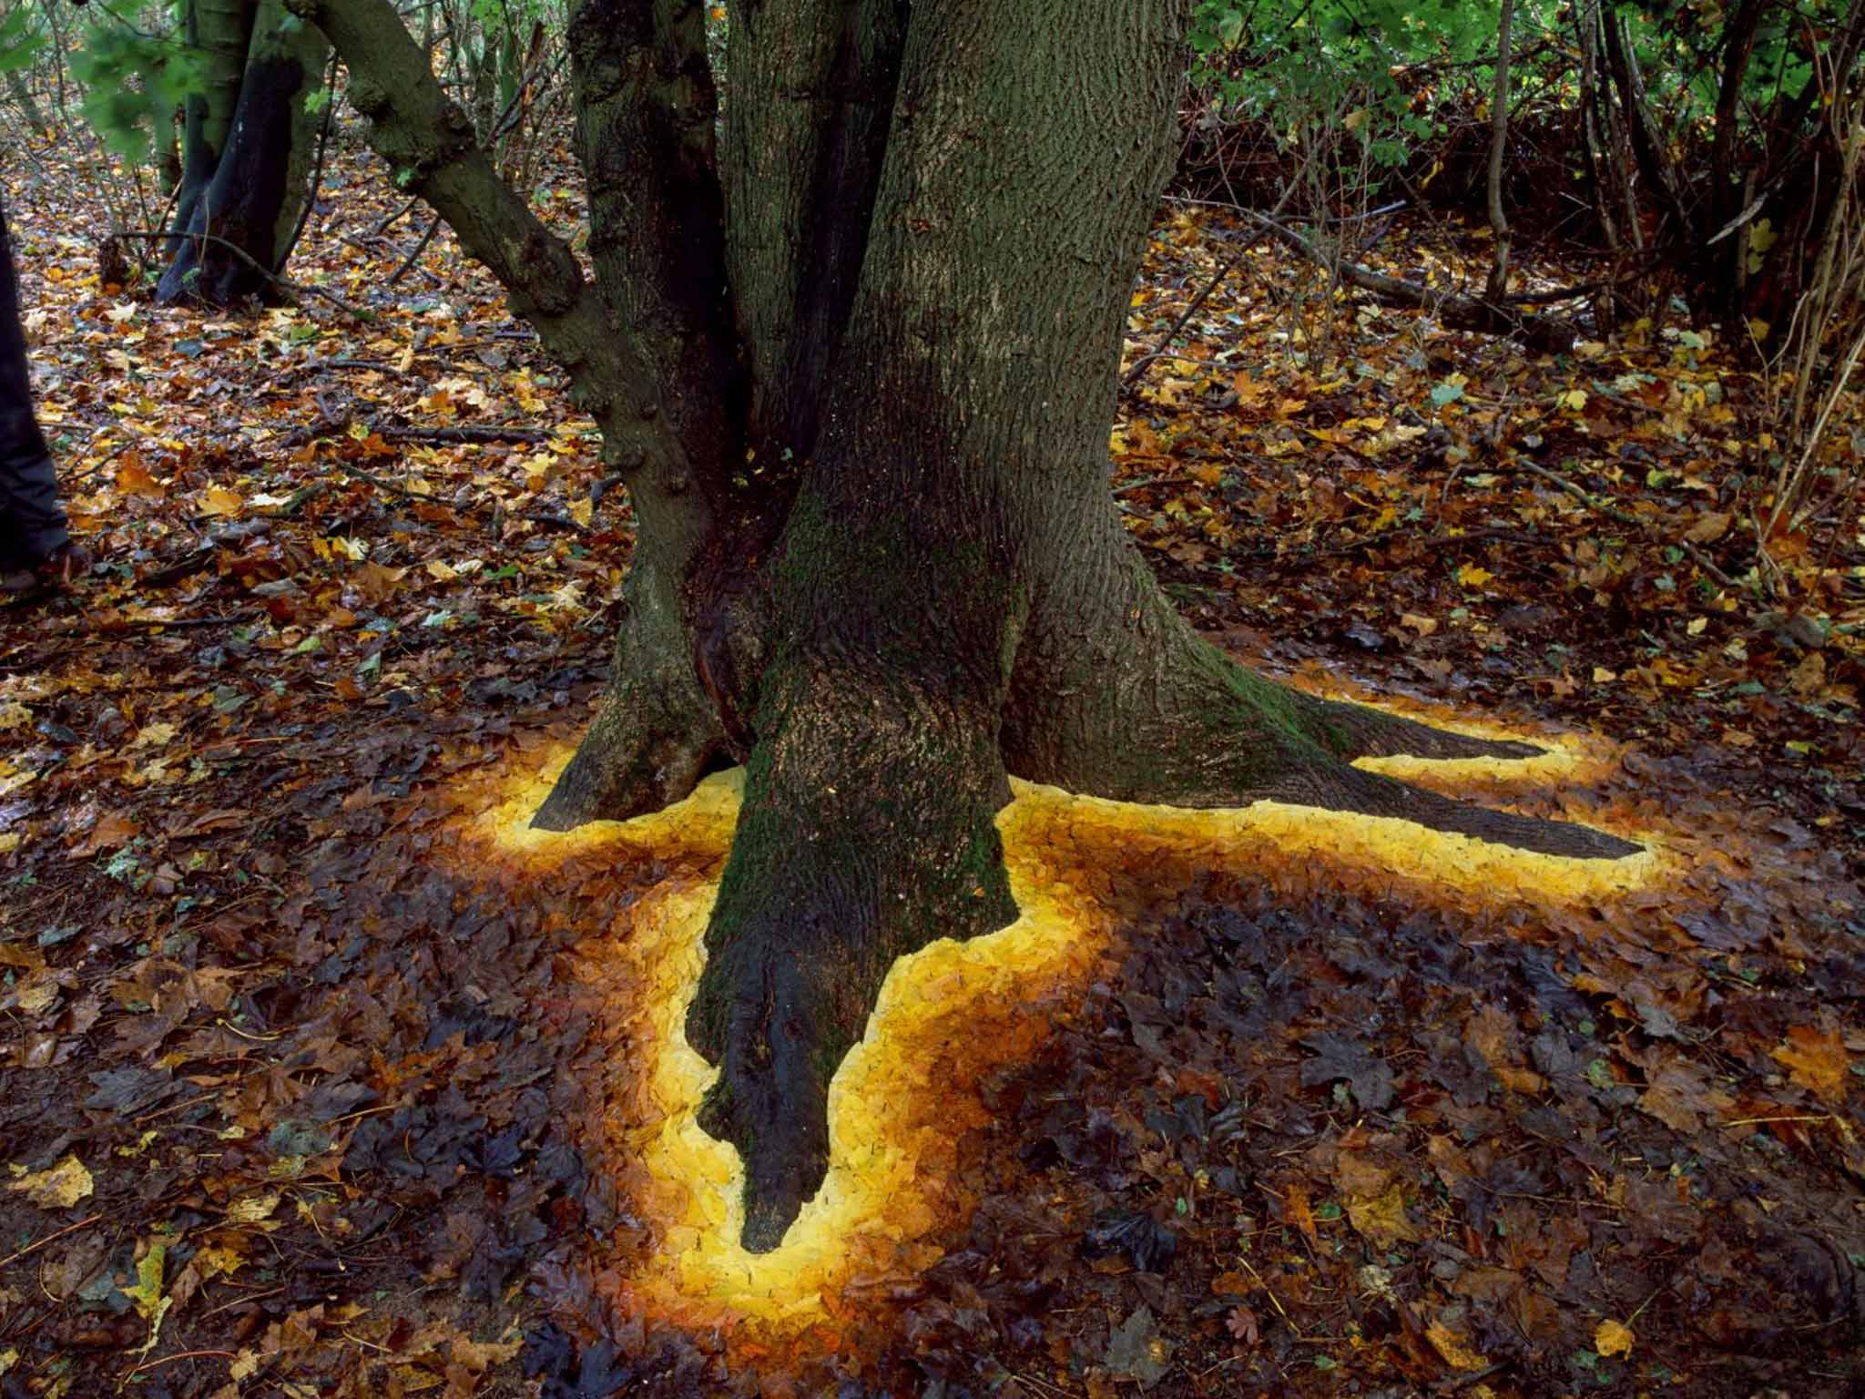
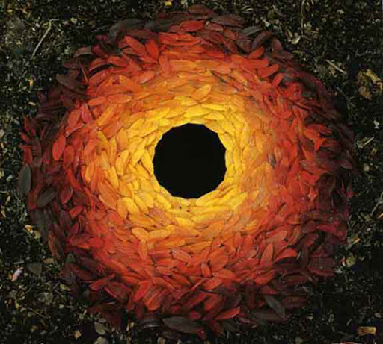
TASK 6:
YWBAT: Create your own installation inspired by Andy Goldsworthy Art work.
Research images of Andy Goldsworthy’s Art work.
Get outside and create your own Goldsworthy inspired Art work.
Photograph and send to your teacher.
ARTIST TIP: Play with different colour surfaces you can find, you could make a series of installations.

